Slide 1
April 24th

Slide 2
PACE Specs
CloudLab Specs
Intel(R) Xeon(R) Gold 6226 CPU @ 2.70GHz or Intel(R) Xeon(R) Gold 6248 CPU @ 2.50GHz (See if we can allocate specific cpu – currently did not check which cpu was allocated for which run)
Tesla V100-PCIE-32GB
Two Intel Xeon E5-2667 8-core CPUs at 3.20 GHz
Tesla V100 SMX2 16GB
Experiment
Entire Imagenet dataset
Use Torch Cuda Events to get idle times in GPU
Use P3Tracer to get data loader times in CPU
Map the two directly using Batch ID
All Out of Order

Slide 3
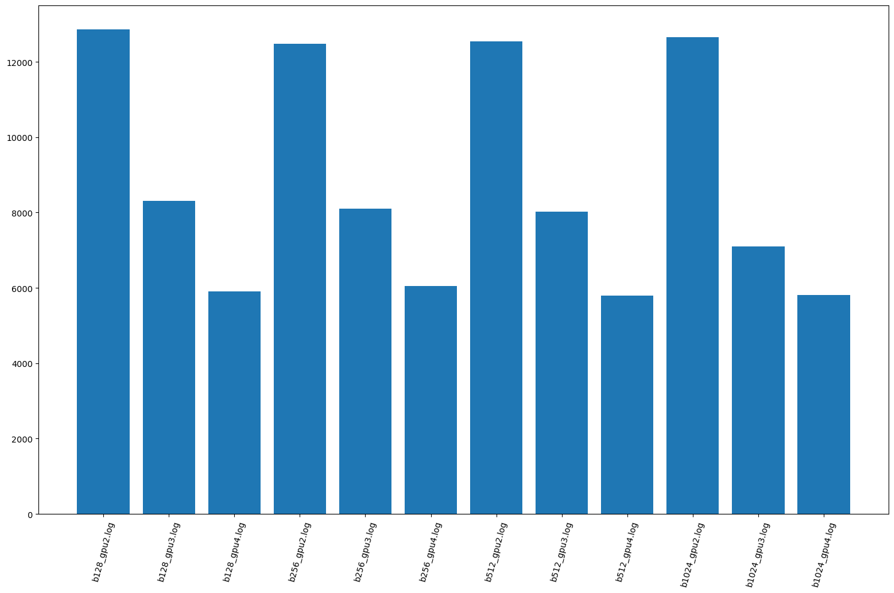
E2E analysis – 1 Epoch, Complete Dataset
12000 s ~ 3.5 h (2 GPU)
8000 s ~ 2.5 h (3 GPU)
6000 s ~ 1.5 h (4 GPU)

Slide 4
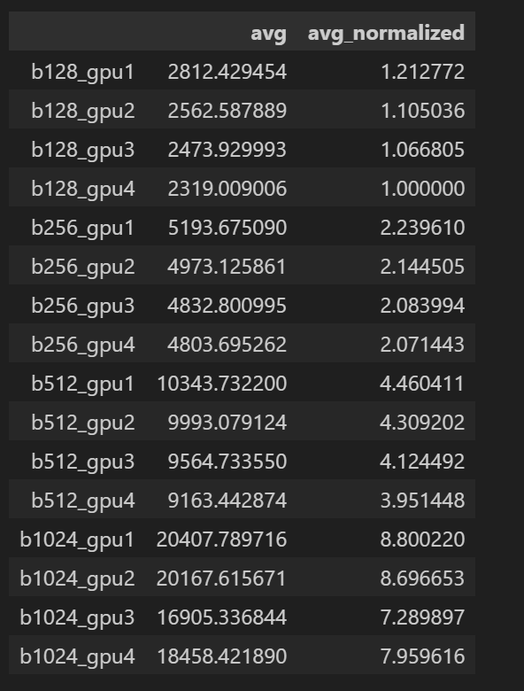
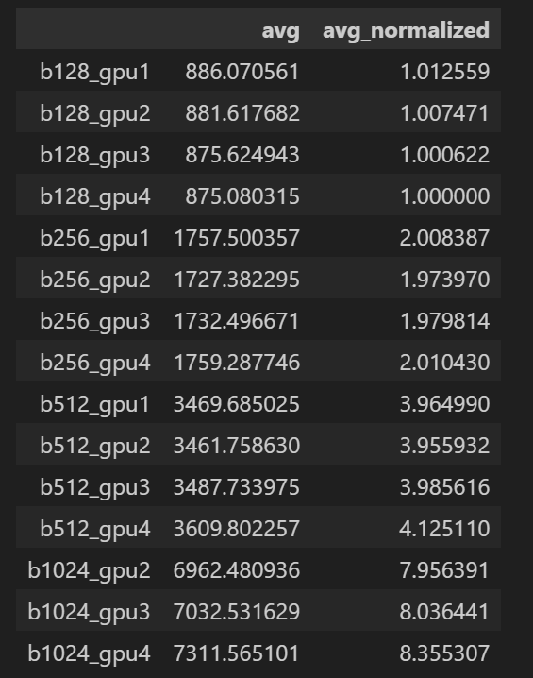
PreProcessing Times
PACE – 3X cloudlab
CloudLab (Rajveer’s Data)
Understand CPU Arch and PACE cluster deployment and node placements

Slide 5
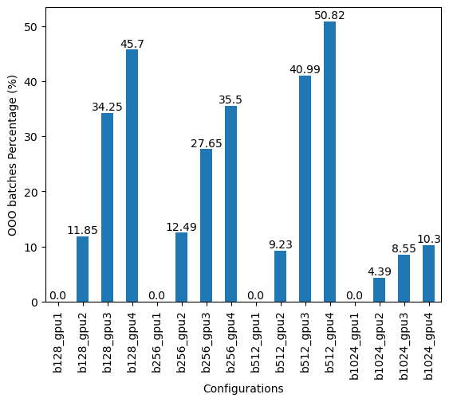
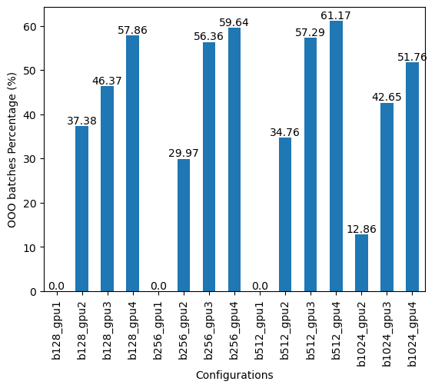
OOO %
PACE
Cloudlab (Rajveer)

Slide 6
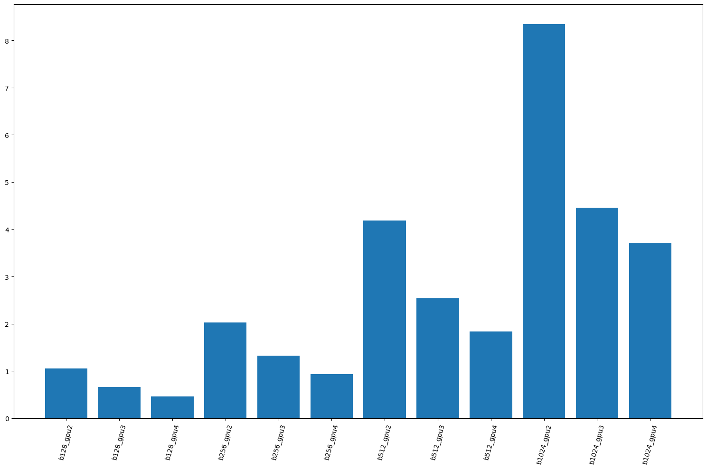
Avg GPU Idle Time
Seconds

Slide 7
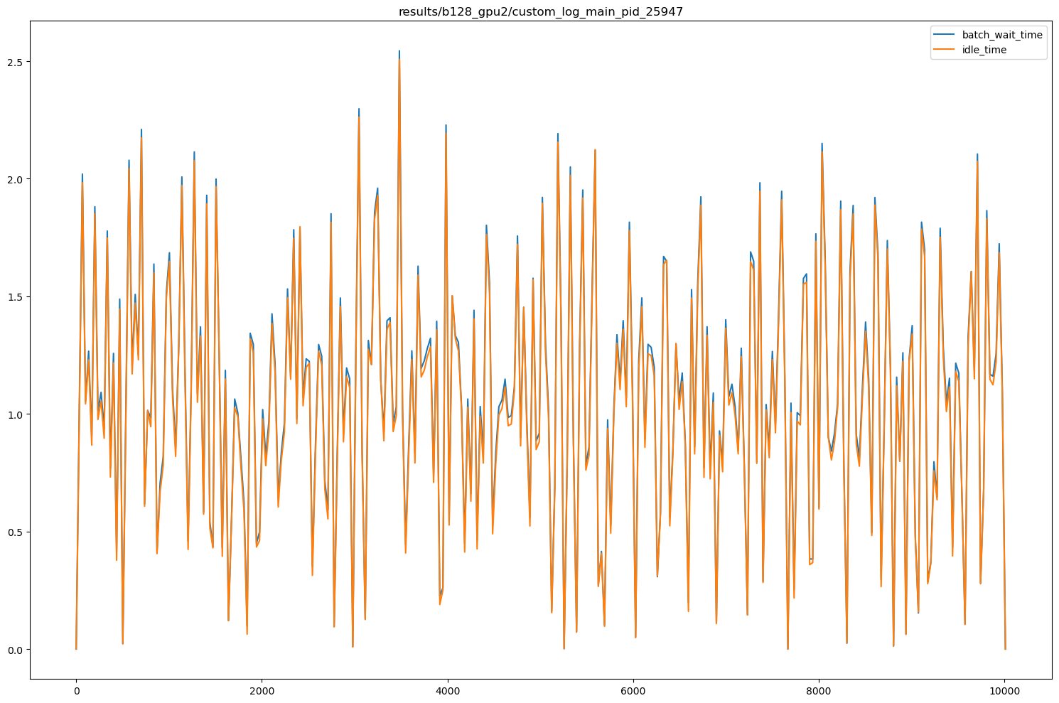
Mapping GPU Idle time to Batch Wait Time

Slide 8
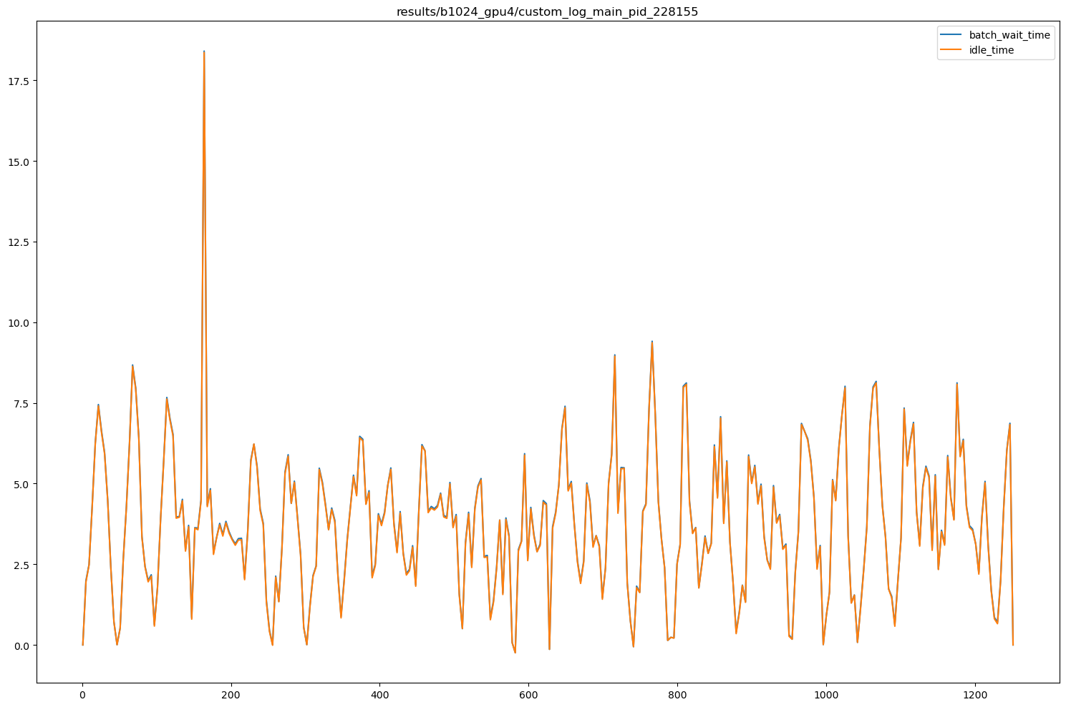
Mapping GPU Idle time to Batch Wait Time

Slide 9
TODO
Reason for Idling – Preprocessing or OOO or…??
Map idling to preprocessing times
Visualise mapping
Analyse the data
Vary dataloaders but keep num_gpu constant

